Slide 1
Amadeus air price benchmark case study
Team c
12/04/2024

Slide 2
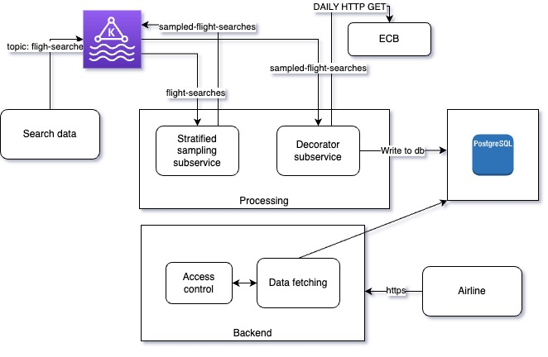
Detailed architecture schema
Kafka to manage scalable communication between subservices
Kafka logs kept with a 1-month retention period in case of errors

Slide 3
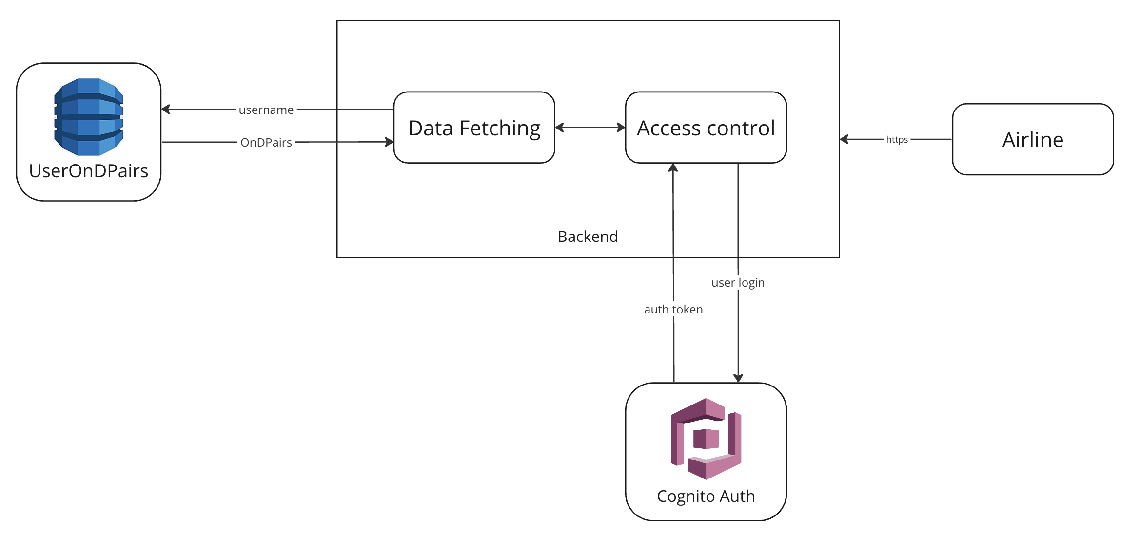
Access management
Cognito to authorize access to the site
DynamoDB to store every OnD pair an airline has access to

Slide 4
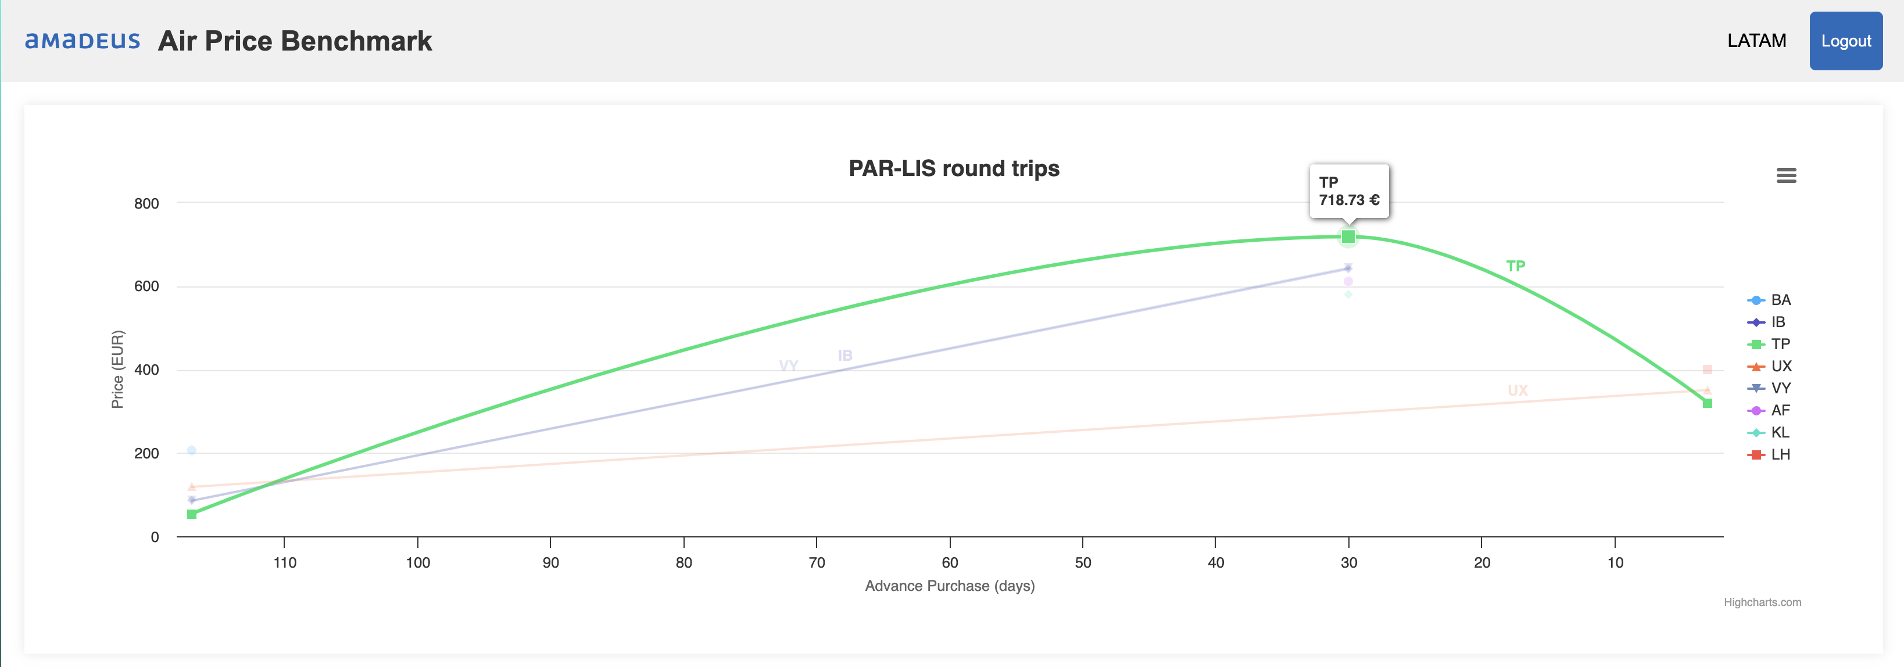
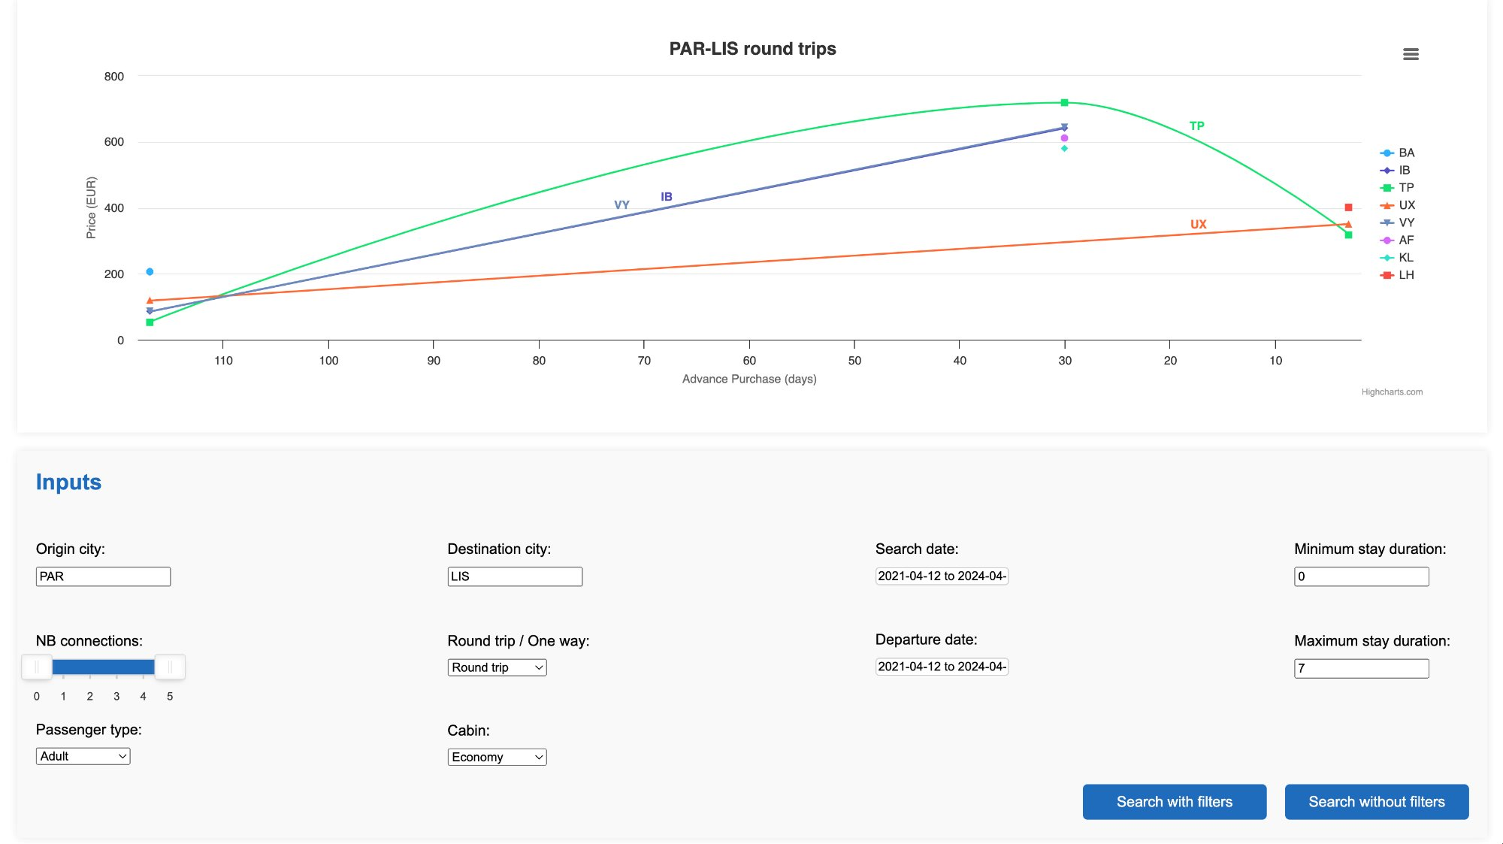
Client UI
Select Origin and Destination City
Apply filters or search without them
See a plot of the selected prices

Slide 5
Stratified sampling
Objective: Maximize information retention by sampling daily searches to even out the distribution of OnDs.
Strategy:
Get data based on historical information on raw input frequency
Update input rate at the end of the day with today’s results
Decision Making:
Base decision making on same day’s rates in previous years
Flexibility: Rates can be adjusted based on previous days rates too if they are too different from previous years.
Search
Search id
Search country
Search date
Search time
Origin city
Destination city
Departure date
Return date
Passengers
Currency

Slide 6
Stratified sampling
Advance purchase with highest nb of searches
SELECT
advance_purchase,
COUNT(*) AS num_searches
FROM
flight_recos
WHERE
ond = ‘new_ond_value’
GROUP BY
advance_purchase
ORDER BY
num_searches DESC
LIMIT 1;
DELETE FROM flight_recos
WHERE search_id IN (
SELECT search_id
FROM (
SELECT search_id
FROM flight_recos
WHERE ond = ‘new_ond_value’
AND advance_purchase = ‘high_adv_purch’
ORDER BY search_date ASC
LIMIT 1
) AS to_delete
);

Slide 7
Monitoring
CPU, memory, and disk usage for each service (managed by the provider)
Usage KPIs:
Query performance
Number of queries for each airline
System availability
Processing KPIs:
Processing performance: time taken to process search data
Number of searches per OnD
Data integrity: number of accepted/rejected data writes to the db

Slide 8
Cost
Component | # of Instances | Monthly cost
Kafka broker | 3 | 78€
EC2 instances for each service | 2 | 14€
Postgres db | 1 | 12€
Total |  | 104€

